Slide 1
Lesson 11 - Mouse Events: Mouse Moved
Mr Mack 2019

Slide 2
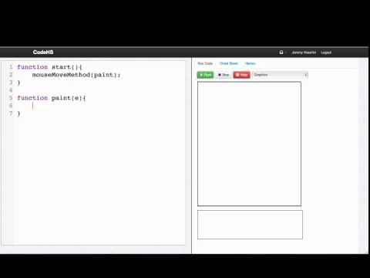

Slide 3
Which statement will call the function paint every time the mouse is moved?
mouseDragMethod(paint);
mouseDownMethod(paint);
mouseMoveMethod(paint);
mouseMoveMethod(paint(e));

Slide 4
Example: Simple Painting
This is an example for this lesson. You are encouraged to play around with it, run and change the code, and learn how it works. When you are done, click continue to go to the next problem.

Slide 5
Example: Colorful Drag to Paint
This is an example for this lesson. You are encouraged to play around with it, run and change the code, and learn how it works. When you are done, click continue to go to the next problem.

Slide 6
Exercise 3.11.1: Coordinates
Write a program that shows the X and Y coordinates of the mouse in a label on the top left of the screen.
You should update the values of the coordinates whenever the mouse moves.

Slide 7
Exercise 3.11.2: Target
Draw a target on the screen that moves to aim at where your mouse is located.
A target consists of a horizontal line that goes from 0 to the window width and a vertical line that goes from 0 to the window height. The lines should cross paths where the mouse is.
You can use line.setEndpoint(x, y) and line.setPosition(x, y) to move the line.
If you’re feeling adventurous, you can extend this to draw a small red circle whenever you click.
If you’re feeling really adventurous, you can have a bouncing ball on the screen and see if you can remove it when it gets clicked. You can use remove(obj) to remove something from the screen and getElementAt(x, y) to get an object at the given position. It will return the object or will return null if there is no object there.

